Slide 1
Illinois Client Enrollment Broker IVR Options

Slide 2
Agenda
Purpose
Inbound IVR Integration Overview
Self Service Options Review
Inbound IVR Flow
Call Back Capture
Questions and Next Steps

Slide 3
Purpose
Review Baseline IVR Components
Present Optional IVR Components

Slide 4
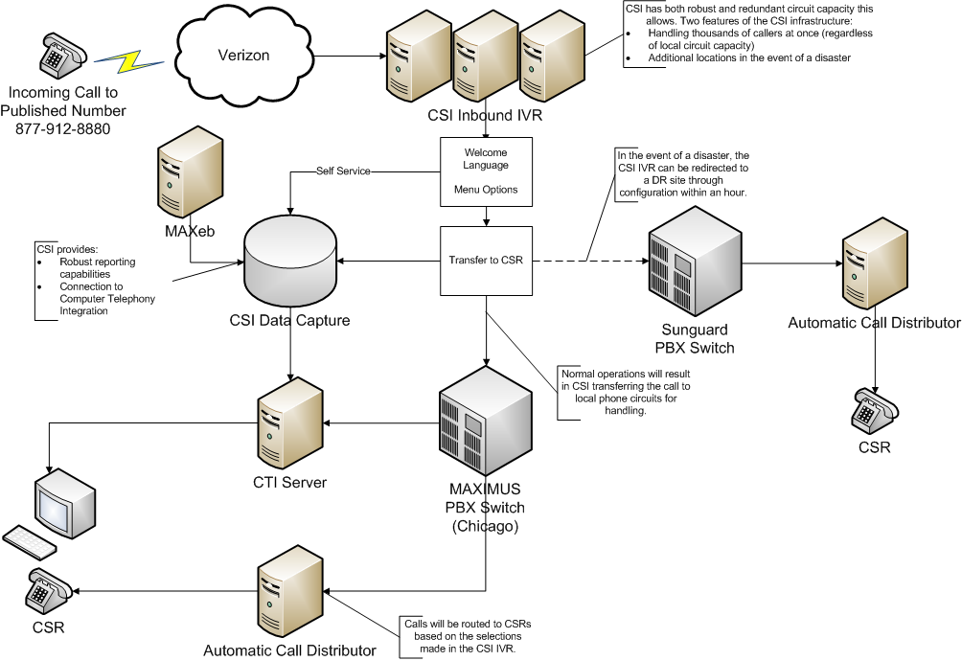
Inbound IVR Integration Overview

Slide 5
MAXIMUS IVR Self Service

Slide 6
Self Service in Louisiana
50,000 Calls per Month
20,000 Self Serve vs 30,000 Transfer to CSR
8,000 Status Calls per Month
3,500 IVR FAQ Calls per Month

Slide 7
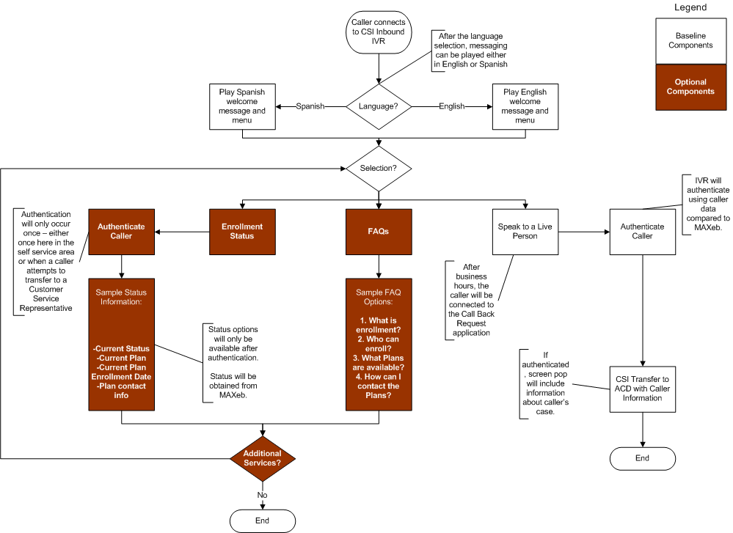
Inbound IVR

Slide 8
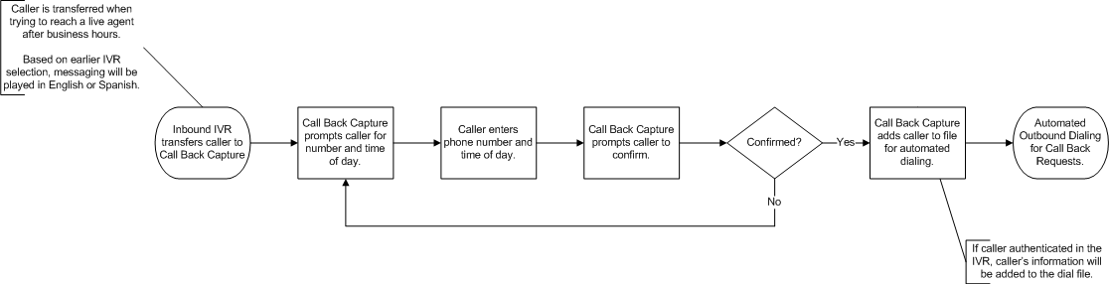
After Hours Call Back Capture

Slide 9
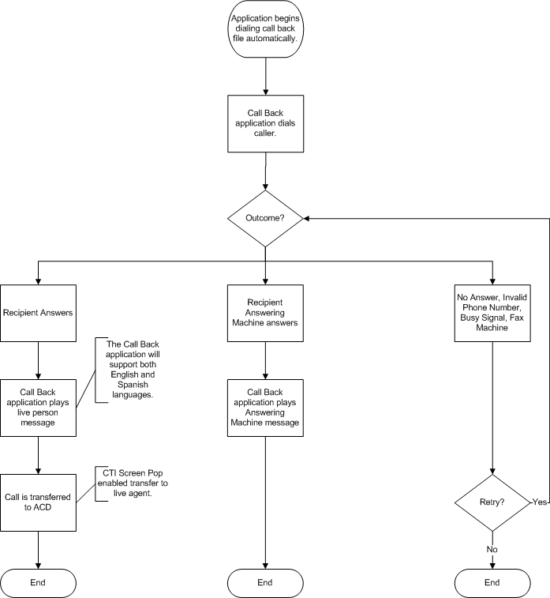
Automated Call Backs

Slide 10
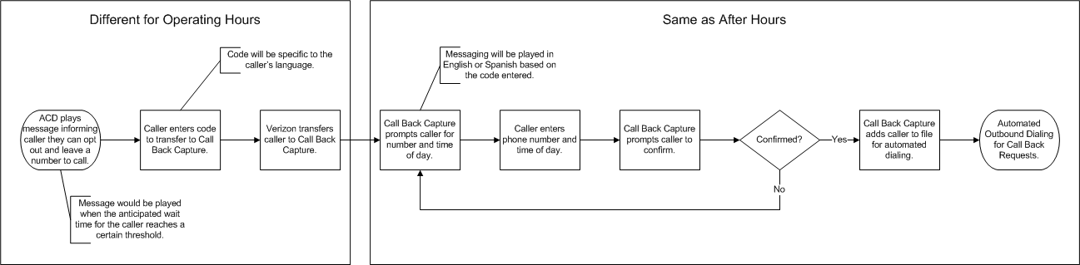
Operating Hours Call Back Capture

Slide 11
Next Steps
Decision on Optional Components
Review Detailed Flows
Approval

